Slide 1
COP 21 An insurance perspective
Clive O’Connell
McCarthy Denning
coconnell@mccarthydenning.com
+44 7774 267149

Slide 2
COP 21
What is a COP?
A Conference of the Parties to the UN Framework
Convention on Climate Change (UNFCCC)

Slide 3
Climate change is not a matter of belief or opinion; it is a matter of fact.

Slide 4
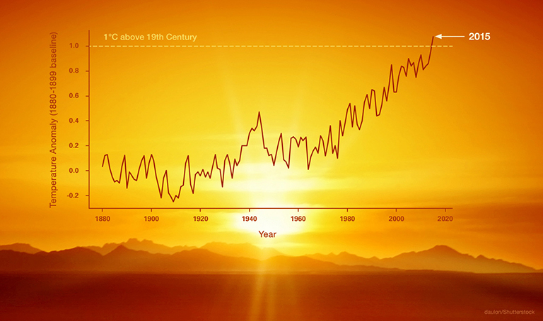

Slide 5
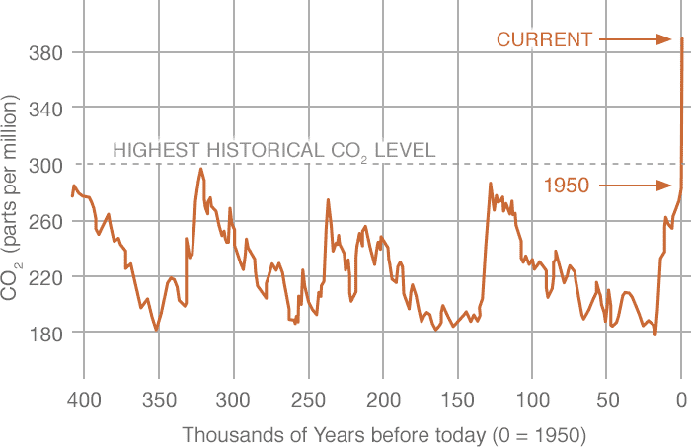

Slide 6
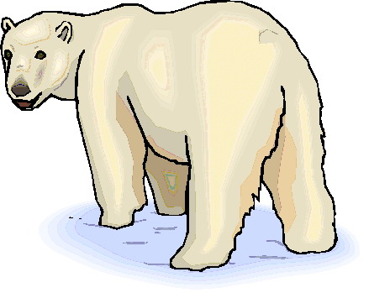
Carbon Dioxide 402.56 parts per million
Highest levels in 650,000 years
Global Temperature up 1.4 F since 1880
Nine of the ten hottest years have been since 2000
Arctic Ice Minimum reducing by 13.3% per decade
2012 lowest level of summer ice on record
Land ice reducing by 287 billion metric tonnes per annum
Greenland ice loss doubled between 1996 and 2005
Sea levels rising by 3.3mm per annum
7 inches in the past century

Slide 7
COP 21 An insurance perspective
The road to COP 21
The negotiations
The agreement
What has been achieved
What has not been achieved
Where does COP 21 leave us
The threat to the insurance industry
The opportunities for the insurance industry
The obligations of the insurance industry

Slide 8
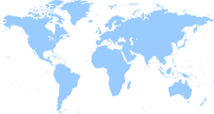
The road to COP 21
Paris
1997 Kyoto
1992 Rio
…and another 20 or so COPs on the way

Slide 9
1992 Rio – Earth Summit
UN Framework Convention on Climate Change (UNFCCC)
Objective;
“To stabilise greenhouse gas concentrations in the atmosphere at a level that would prevent dangerous anthropogenic interference with the climate system"

Slide 10
1997 Kyoto Protocol
A treaty that acknowledged climate change and the man made causes of climate change and committed the parties to it to reduce greenhouse gases.
Binding targets for the reduction of greenhouse gas emissions
carbon dioxide (CO2),
methane (CH4),
nitrous oxide (N2O),
sulphur hexafluoride (SF6)
USA did not ratify
Canada, Japan and Russia withdrew.

Slide 11
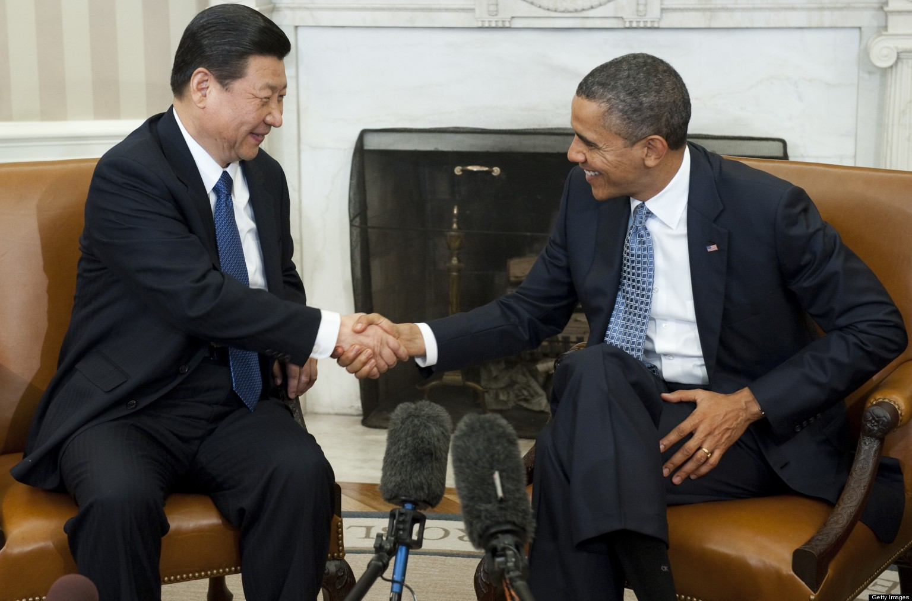
Breakthrough – 12 November 2014
Kyoto in disarray.
Two greatest producers of noxious emissions; USA and China
President Obama and General Secretary Xi Jinping agreed to limit greenhouse gases emissions

Slide 12
COP 21 – Finding a balance
Reluctance to agree anything binding
Ambitions of emerging economies
Existing infrastructures of developed economies
Need for universal acceptance
Global urgency
Local urgency
Need for real commitment

Slide 13
COP 21
Parties submitted estimates for reductions that they could make to emissions – Nationally Determined Contributions (NDCs)
Results were amalgamated to produce a global picture.
196 countries agreed to reduce emissions “as soon as possible” so as to keep global warming to below 2°C
Now being ratified by 55 most developed nations.

Slide 14
COP 21
Parties must make successive emission reduction commitments and “shall pursue domestic mitigating measures”
“A balance between antropogenic emissions by sources and removals by sinks of greenhouse gases in the second half of this century
“Well below 2°C… and to pursue efforts to limit the temperature increase to 1.5°C”
Clear five year cycles for raising ambition linked o a global stock take on progress towards the long term goal. Starting with a review of current climate action contributions by 2018, to be resubmitted by 2020.

Slide 15
COP 21
Converges towards a common framework with a mandate to firm up modalities in future
Clear objective of shifting all finance flows to low carbon resilient investments. A new collective climate finance goal (beyond the current level of $100 bn) will be set in 2025. It also secures greater clarity, predictability and transparency of finance

Slide 16
COP 21
New adaption goal elevated the need to plan for climate impacts in iterative cycles under the UNFCCC, increased share of finance for adaptation and mechanism to deal with insurance and displaced people
Nearly 150 leaders attended and pledged to accelerate climate action at national and international level, including through the implementation of their climate action contributions
Climate action prioritised in Sustainable Development Goals (SDGs). G20 Financial Stability Task Force launched

Slide 17
COP 21
Large number of commitments to ambitious investment in clean energy and divestment from fossil fuels from cities, regions, investors and business
All major business and investors groups lobbied for strong long term goal and robust rules to increase ambition

Slide 18
COP 21 - Reasons to celebrate
196 countries reached an agreement
USA and China were both party to the agreement
First time that climate change has been globally recognised and action taken to combat it on a global basis
A first step on the road to recovery

Slide 19
COP 21 – Reasons to be cautious
Non binding
Still to be ratified – will US ratify?
Still allows temperatures to rise by up to 2°C from an already high base which some consider to be beyond the point of no return
Is it too little; too late?

Slide 20
So what happens now?
Temperatures will continue to rise
Climate change will continue
More floods
Worse storms
Diminishing ice mass
Rising sea levels…
…only not quite as fast as would otherwise do

Slide 21
The Threat to the Insurance Industry
Climate Change is already upsetting risk modelling
More severe storms?
Flooding?
Urbanisation
Sustainability

Slide 22
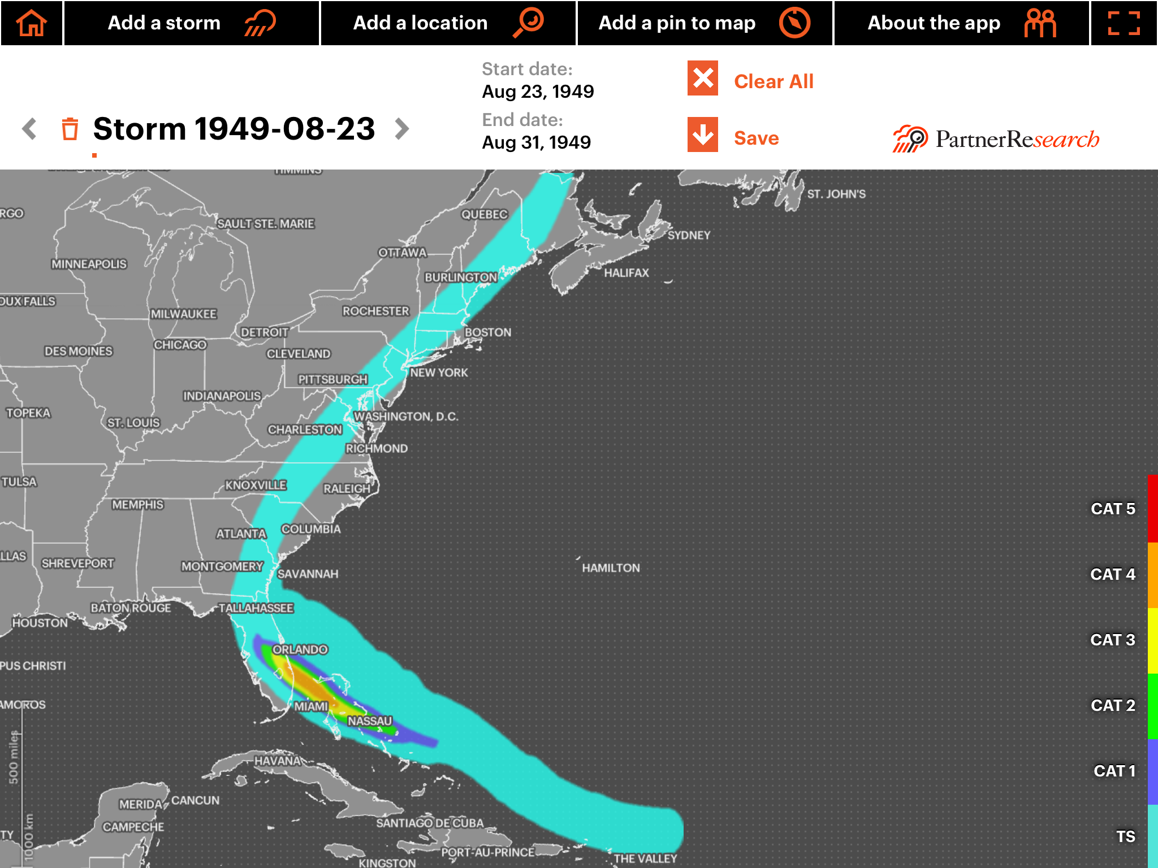

Slide 23
1949 Florida hurricane
2 deaths
$53 million of losses

Slide 25
A solution – Flood Re
The housing crisis – a small densely populated island
Building on flood plains and disruption of drainage
The result: widespread flooding of homes.
Homes uninsurable or not insurable at an affordable price
April 2016 (currently awaiting approvals from PRA and FCA)
Initiative between government and insurance industry
Annual levy on all household insurance plus premiums
Flood risk (save for £250 deductible retained by insurers) reinsured

Slide 26
Opportunities
Superstorm Sandy
50% of economic loss uninsured
UK
55% catastrophe insurance penetration

Slide 28
Philippines - Typhoon Haiyan
6,340 dead
550,000 homes destroyed
580,000 homes severely damaged
$2.86 billion loss
1% of loss insured

Slide 29
Opportunities
Greater penetration of insurance into developed markets
Insuring emerging markets
Insuring new risks
New energy sources
Carbon sinks
Regulatory protections

Slide 30
Obligations
Investment
Insurers are among most significant investors.
Greening of investment strategies

Slide 31
Obligations
The UNEP FI Principles for Sustainable Insurance
We will embed in our decision-making environmental, social and governance issues relevant to our insurance business.
We will work together with our clients and business partners to raise awareness of environmental, social and governance issues, manage risk and develop solutions.
We will work together with governments, regulators and other key stakeholders to promote widespread action across society on environmental, social and governance issues.
We will demonstrate accountability and transparency in regularly disclosing publicly our progress in implementing the Principles.

Slide 32
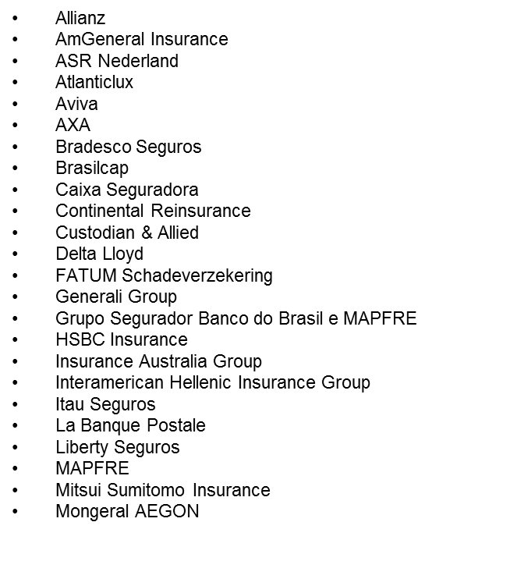
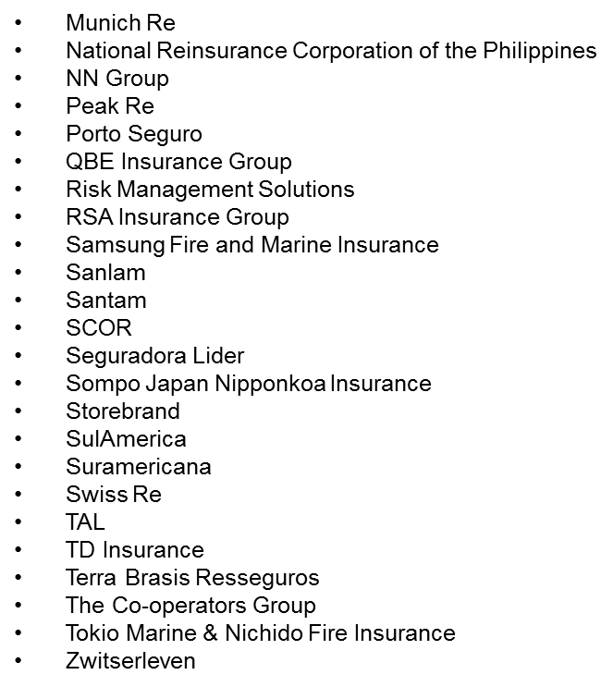

Slide 33
COP 21 An insurance perspective
Clive O’Connell
McCarthy Denning
coconnell@mccarthydenning.com
+44 7774 267149

